Slide 1
ING 112A Spring 2022 ONLINE COURSE Week 2 UNIT 1- ACADEMIC WRITING GUIDELINES for FORMAL WRITING
ASLI ÖZKARA
ITU, ADVANCED ENGLISH PROGRAM

Slide 2

What did we learn last week?
Going over the Syllabus
How to write proper e-mails
How to use different online dictionary types

Slide 3
What are we going to learn today?
The differences between informal & formal writing styles
The guidelines to follow while writing formally

Slide 4
What is Academic Writing?
Academic writing is a writing style employed by scholars and researchers to define their disciplines and to express the methods and findings of their academic and scientific studies.
It is a formal writing style.
It differs from other formal writing styles in several ways in terms of AUDIENCE, TONE and PURPOSE and it has certain rules.

Slide 5
What is audience in writing?
Audience is your reader.
It determines the content.
It determines the level.
In academic writing, the audience is usually scholars, researchers and students.
WHO?

Slide 6
What is Tone?
Tone is the attitude of the writer.
Serious?
Humorous?
Threatening?
Light-hearted?
Formal?
Informal?
In academic writing, the tone is formal.
Academic texts require formal use of language and scientific, advanced vocabulary.
how?

Slide 7
What is Purpose?
Purpose is the reason to write.
to entertain?
to teach?
to document?
to persuade?
In academic writing, the purpose is to give information with a clear presentation of a specific topic.
why?

Slide 8
Academic article vs. Non-academic article
written by professionals
edited by peers and take years to publish
formal language and field terminology
author names & credentials are present
a list of references
published in scientific journals
written by anyone for the mass public
published quickly
(in)formal, casual language
author is not obligatory presented
no reference list
published in non-scientific magazines, newspapers, blogs, etc.

Slide 9
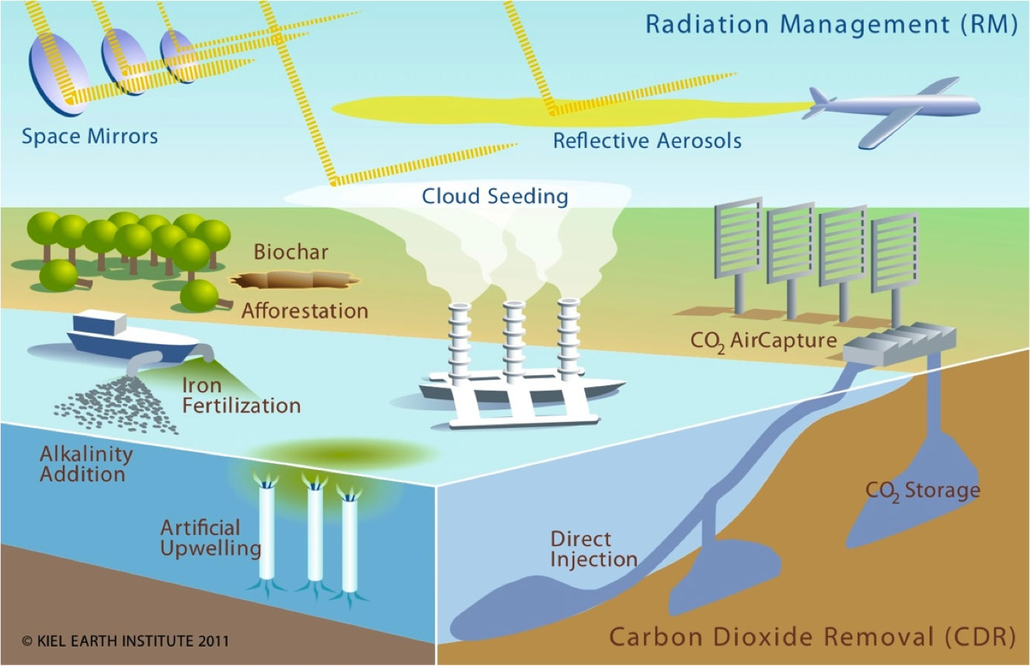
p. 8, Exercise1
Identify the tone (formal or informal) and the audience of the texts 1, 2 & 3 about “GEOENGINEERING”.

Slide 10
“In the 1970s, discussion of “geoengineering”, a radical strategy for arresting climate change by intentional, direct manipulation of the Earth’s energy balance, began to appear in the climate science literature. With growing international concern about the pace of climate change, the scientific and public discourse on the feasibility of geoengineering has recently grown more sophisticated and more energetic” (Hemming & Hangler, 2011).
Tone:
Formal (an academic article)
Audience:
Academicians, researchers, students

Slide 11
This week’s conference drew attention to the risks involved in geoengineering. After the conference, leading researchers and campaigners expressed concern that geoengineering research could be used as an excuse not to reduce CO2 emissions.
Tone:
Formal (newspaper article)
Audience:
General public

Slide 12
Geoengineering is an insane attempt at fixing the climate change by tinkering with the atmosphere. I think, it bites off more than it can chew. It is not likely that technology will be a solution to climate change. Am I wrong for thinking that it sounds insane? What do you think? Please, share your comments.
Tone:
Informal (blog entry)
Audience:
Science enthusiasts, general public

Slide 13

pp. 9-12, Guidelines for academic writing There are 9 criteria for formal writing style.

Slide 14
Guidelines for Academic Writing - 1
AVOID USING SHORT FORMS
contractions
can’t – cannot don’t – do not he’s – he is
abbreviations
e.g. For example Prof. Professor
i.e. that is info information
ad advertisement TV television
acronyms
ITU – Istanbul Technical University
(When first used, acronym can be given in parentheses. For the rest of the text you can use only the acronym.)
School of Foreign Languages (SFL) issued a new learning directory. This is the second directory issued by SFL in 2018-2019 academic year.

Slide 15
Guidelines for Academic Writing - 2
AVOID USING INFORMAL VOCABULARY
simple words & phrases
good/bad (menti.com)
good satisfactory/beneficial/valuable, etc.
bad severe /adverse/ineffective/flawed, etc.
colloquial words & phrases
kids children gonna going to fire dismiss get stuff
vague words & phrases
The report presents many things.
The report presents many details/ findings, etc.
This topic has interested researchers for a long time.
This topic has interested researchers for more than 30 years.
unnecessary words & phrases
This chapter serves to explain …
This chapter explains …

Slide 16
Guidelines for Academic Writing - 3
AVOID USING INFORMAL VOCABULARY
phrasal verbs
work out solve cut down reduce
idioms
get out of hand be out of control
informal phrases
day by day gradually / in time
more or less approximately / nearly
slang
screw up make a mistake
emotional language
amazing results satisfactory results
clichés
In today’s world Throughout history

Slide 17
Replace the idiom with a formal word: "The new economic policy saves farmers from relying on the government help till the end of time."

Slide 18
Replace the phrasal verb with a formal verb: "To establish absolute control, the dictator tried to wipe out all who were opposed to him."

Slide 19
Guidelines for Academic Writing - 4
AVOID A PERSONAL TONE (I/you/we/us/your, etc.)
I think In my opinion I guess
We think You must
I think you should abandon your prejudice against women’s involvement in science.
People/The society should abandon their/its prejudice against women’s involvement in science
The gendered prejudice against women’s involvement in science should be abandoned.
I want to argue about the capabilities of local authorities.
It is necessary to / There is a need to argue about the capabilities of local authorities.

Slide 20
Go to breakout rooms
Word document is in
Ninova Class Files
“Week 2 Exercise for breakout room-Avoiding personal pronouns”
Chat box

Slide 21
Rewrite the sentences to avoid the use of personal pronouns using the words given in parentheses.
Moreover, I will describe early warning systems for earthquakes.
(described)
PASSIVE VOICE
Moreover, early warning systems for earthquakes will be described.

Slide 22
C. Rewrite the sentences to avoid the use of personal pronouns using the words given in parentheses.
2. Before I proceed to the use of early warning systems in earthquake detection, let’s provide some background information.
(proceeding / provided)
BEFORE/AFTER/WHEN/WHILE + -ING (if subjects are the same in both clauses)
Before proceeding to the use of early warning systems in earthquake detection, some background information will be provided.

Slide 23
C. Rewrite the sentences to avoid the use of personal pronouns using the words given in parentheses.
3. After the earthquake, authorities did not inform us properly about the number of casualties.
(information)
WORD FORM CHANGE
After the earthquake, authorities did not give proper information about the number of casualties.
WORD FORM CHANGE + PASSIVE
After the earthquake, proper information was not given about the number of casualties.

Slide 24
C. Rewrite the sentences to avoid the use of personal pronouns using the words given in parentheses.
4. We could not recover from the post traumatic effects of the earthquake for years.
(recovery / lasted)
WORD FORM CHANGE
Recovery from the post traumatic effects of the earthquake lasted for years.

Slide 25
Guidelines for Academic Writing - 5
USE PROPER PUNCTUATION AND CAPITALIZATION
Avoid brackets ([ ]), parentheses (()), dashes (-) and exclamation marks (!)
Do not give examples in parentheses in a sentence
In academic writing there are various citation methods (APA and Oxford).
In academic writing there are various citation methods such as APA and Oxford.
Pay attention to use capital letters when you start a new sentence.

Slide 26
Guidelines for Academic Writing - 6
AVOID USING
questions
What are the best solutions?
The best solutions are …………. .
commands
Measure the surface tension of various liquids using both capillary and ring methods. Then, calculate the surface tension.
The surface tension of various liquids is measured using both capillary and ring methods. Then, the surface tension is calculated.
*USE passive voice

Slide 27
Guidelines for Academic Writing - 7
AVOID SHORT AND SIMPLE SENTENCES
This is a classic field experiment. It uses game theory and the prisoner's dilemma.
This is a classic field experiment using game theory and the prisoner's dilemma.

Slide 28
Guidelines for Academic Writing - 8
USE SUITABLE COLLOCATIONS
experiment (n)
VERB
conduct / carry out / do / perform / design / report an experiment
ADJECTIVE
a successful / simple / controlled / scientific / psychological experiment
PREPOSITION
during / in the experiment

Slide 29
Guidelines for Academic Writing - 9
PREFER PASSIVE VOICE
Highlight the action rather than the doer.
lab reports, research papers
ACTIVE
First, you should calculate the surface tension.
PASSIVE
First surface tension is calculated/should be calculated.

Slide 30
In summary,
1. NO contractions, abbreviations & acronyms!
2. NO phrasal verbs, idioms, informal phrases, slang, emotional language, clichés!
3. NO personal tone!
4. Use proper punctuation and capitalization!
5. NO questions & commands!
6. NO short and simple sentences!
7. NO simple, colloquial, vague & unnecessary words and phrases!
8. Use suitable collocations!
9. Prefer passive voice.

Slide 31
Exercise: In each sentence there are two informal usages. Rewrite the sentences in a formal style.
There’s high inflation in the country, i.e. the prices increase and value of money decreases.
AVOID CONTRACTIONS
AVOID ABBREVIATIONS
There is high inflation in the country, that is the prices increase and value of money decreases.

Slide 32
2. Apply the guidelines of the (APA) American Psychological Association citation manual.
AVOID COMMANDS
SHOW the ACRONYM after the FULL FORM
The guidelines of the American Psychological Association (APA) citation manual are applied.

Slide 33
3. What measures can we take against climate change? This is the main concern.
AVOID QUESTIONS
AVOID SHORT SENTENCES
The main concern is what measures can be taken against climate change.
What measures can be taken against climate change is the main concern.

Slide 34
4. In the last decade, some species (Eastern cougar, Yangtze river dolphin, Formosan leopard) went extinct because of bad treatment of the environment.
AVOID PARANTHESES
AVOID SIMPLE WORDS
In the last decade, some species such as Eastern cougar, Yangtze river dolphin, Formosan leopard went extinct because of ill-/ improper/poor treatment of the environment.

Slide 35

This is the end of Week 2. Please, follow the announcements for the next session.

